Slide 1
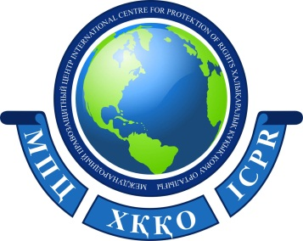
The State Public Association
"International Human Rights Center"
Mediation Center
School of Mediation and Negotiation
The Republic of Kazakhstan,
Almaty city
Website: mpc-info.kz

Slide 2
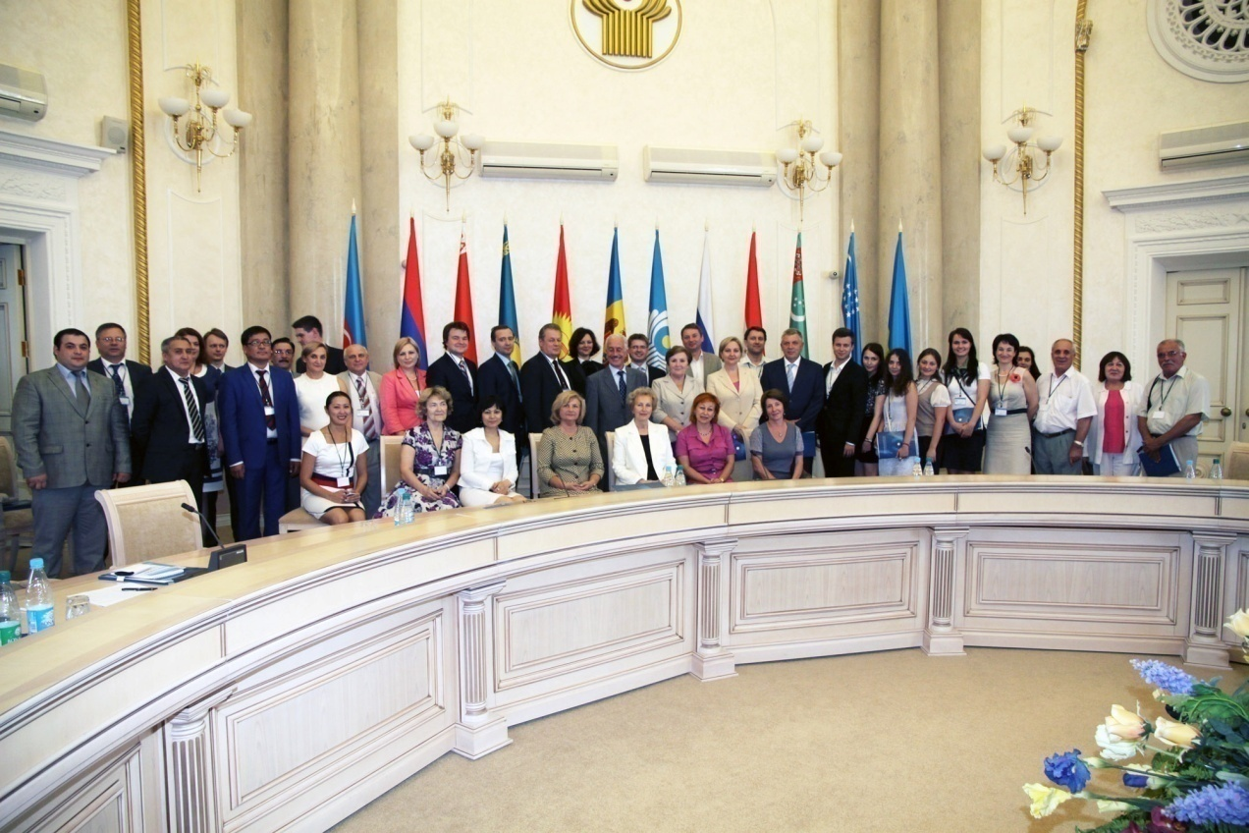
The State Public Association “International Human Rights Center” (hereinafter referred to as IHC) was created in 1997 and has been successfully carrying out its legal and mediation activities for 27 years.
The head and founders of the "International Human Rights Center" are:
• The Association of legal entities “The Association of Mediators of Kazakhstan”,
• The Consortium of Central Asian Mediators,
• Eurasian Union of Mediators (CIS).
As part of these events, every year various international events are held to develop mediation in Kazakhstan, Central Asia and the CIS
The participation of the International Human Rights Center in the Community of Mediators of the Turkic Countries is currently being discussed.

Slide 3
Zhakupov Zhandilda Azhigalievich The President of the SPA "International Human Rights Center" is He is also an international class trainer-mediator in the "Association of Mediators of Kazakhstan" The lecturer of the Academy of Public Administration under the President of the Republic of Kazakhstan The member of working groups of the Parliament of the Republic of Kazakhstan The chairman of the Mediation Council of the city of Almaty of the “Assembly of the People of Kazakhstan” The Master of Law, the author of the E-mediation projects He was awarded four times by the the President of the Republic of Kazakhstan and received different medals for his work.

Slide 4
The mission of the organization is to provide legal and mediation assistance to socially vulnerable segments of the population, individually and legal entities by providing legal advice and conducting mediation procedures
The main activities of the IHC are:
• promoting the development of democratic processes, building a civil society and the rule of law, introducing and developing the institution of mediation in Kazakhstan;
• provision of legal and mediation assistance;
• training professional mediators, maintaining their register;
• development of projects and programs on the protection of human rights, the development of mediation and reducing the level of conflict in society;
• expansion and strengthening of international relations on legal and mediation issues.

Slide 5
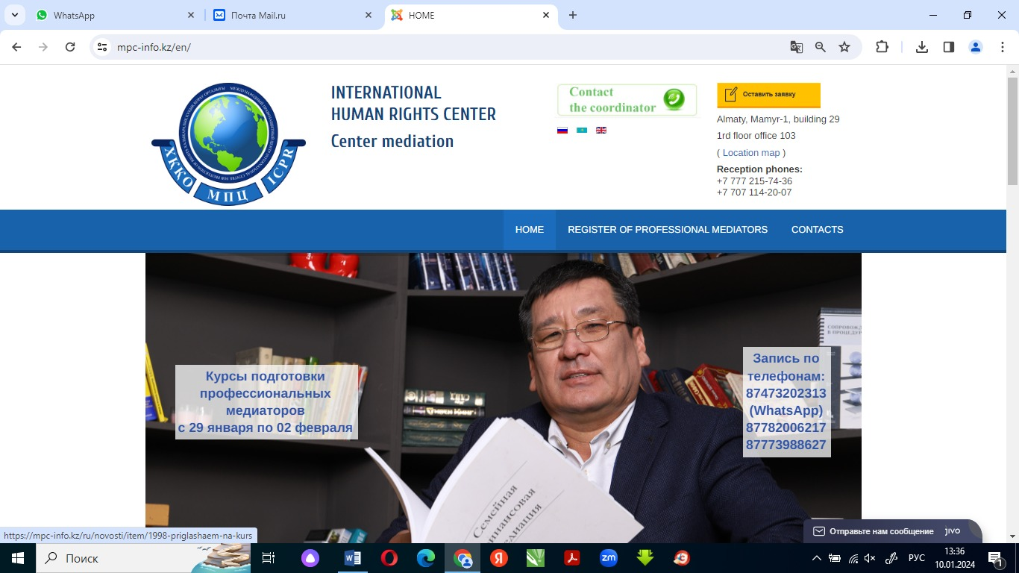
In the IHC operates the Mediation Center and a Mediator Training School.
The International Human Rights Center provides mediator services and maintains a register of them. Today, the IHC register includes 500 mediators who work in twenty regions of Kazakhstan and also abroad.
The mediators of the center annually conduct 1,500 to 5,000 conciliation procedures which worth up to 35 million US dollars and more than 90% of them are completed with reconciliation and the conclusion of a mediation agreement.

Slide 6
Every year the number of mediations conducted by our Center grew annually by a thousand disputes:
• in 2016 - 2000 mediations,
• in 2017 – 3000 mediations,
• in 2018 – 4000 mediations,
• in 2019 – 5,000 mediations.

Slide 7
During the pandemic 2020, the total number of disputes resolved by our Center mediators decreased by half, but the amount of disputes increased by 2.5 times. This was due to restrictive measures for mediators. But the pandemic showed the need for peaceful resolution of disputes and the importance of communication; business was forced to resolve disputes independently in the new conditions, this contributed to the resort to mediation and an increase in the amount of disputes

Slide 8
• The bulk of mediations are carried out on civil disputes, including business disputes, 80-85% of the total number of mediations, on criminal disputes - 15%, on administrative disputes - 5%.
• The bulk of mediations are carried out at the pretrial stage, especially in recent years due to a shift in emphasis to pretrial mediation settlement and changes in legislation.
• Often our Center's mediators conduct business mediations on disputes related to non-fulfillment of contractual relations (violation of terms of contracts for the supply of goods, provision of services, failure to fulfill payment obligations, etc.).
5%
adm
15%
Criminal disputes
80%
Civil disputes

Slide 9
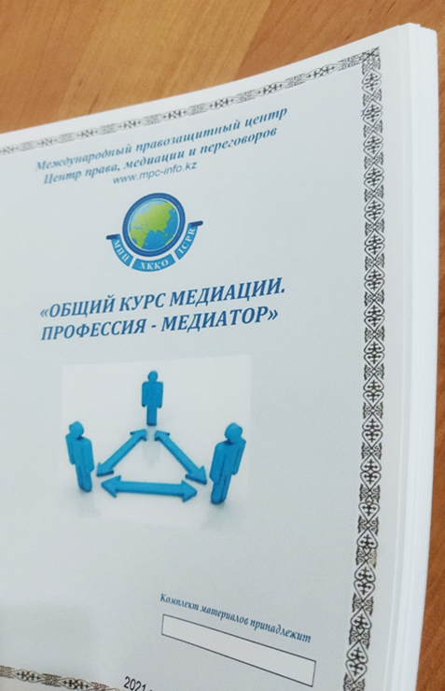
More than 1,900 mediators have been trained at the IHC Mediator School.
Our mediators are trained in the state and Russian languages according to the original programs of mediator trainers, who have also developed methodological manuals with samples of mediator documents and collections of legal acts on mediation.
The teachers of the center with more than 10 years of experience are practicing mediators, they also have been trained in supervision and other topics by trainers from Bulgaria, Spain, the USA, Great Britain, and Ukraine.

Slide 10
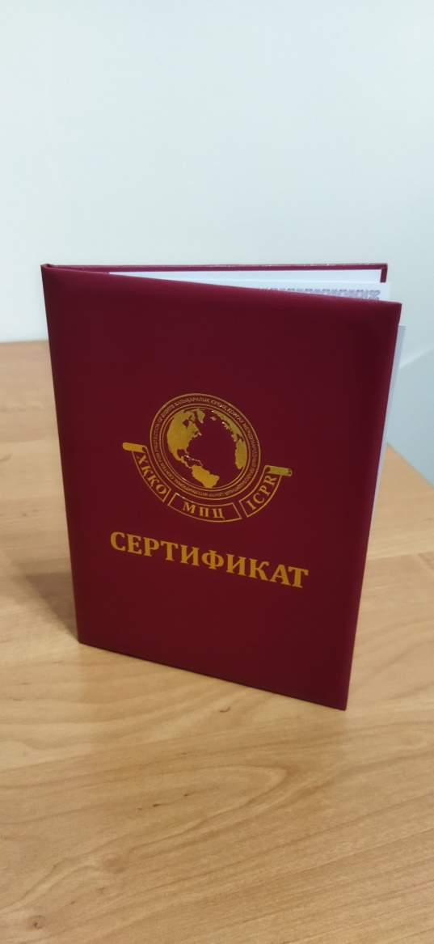
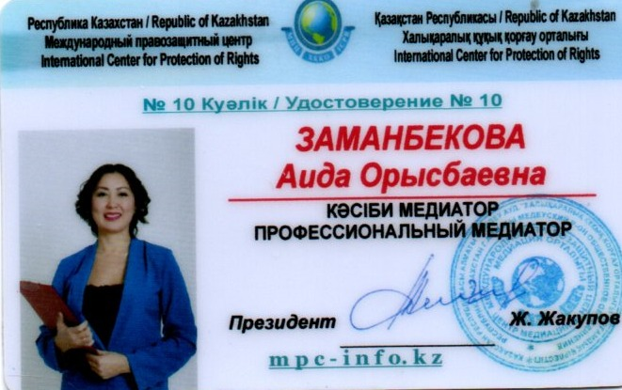
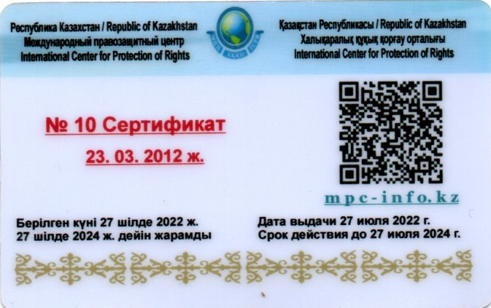
Mediator courses are held at our Center every month.
At the end of the course, participants take an exam and, if they pass, they receive a certificate and a professional mediator license confirming their active status.
Law of the Republic of Kazakhstan "On Mediation", Article 10.
Rights and duties of a mediator
2. A mediator obliged to:
6) regularly improve his/her professional level under the mediator training program according to the rules determined by the Government of the Republic of Kazakhstan.

Slide 11
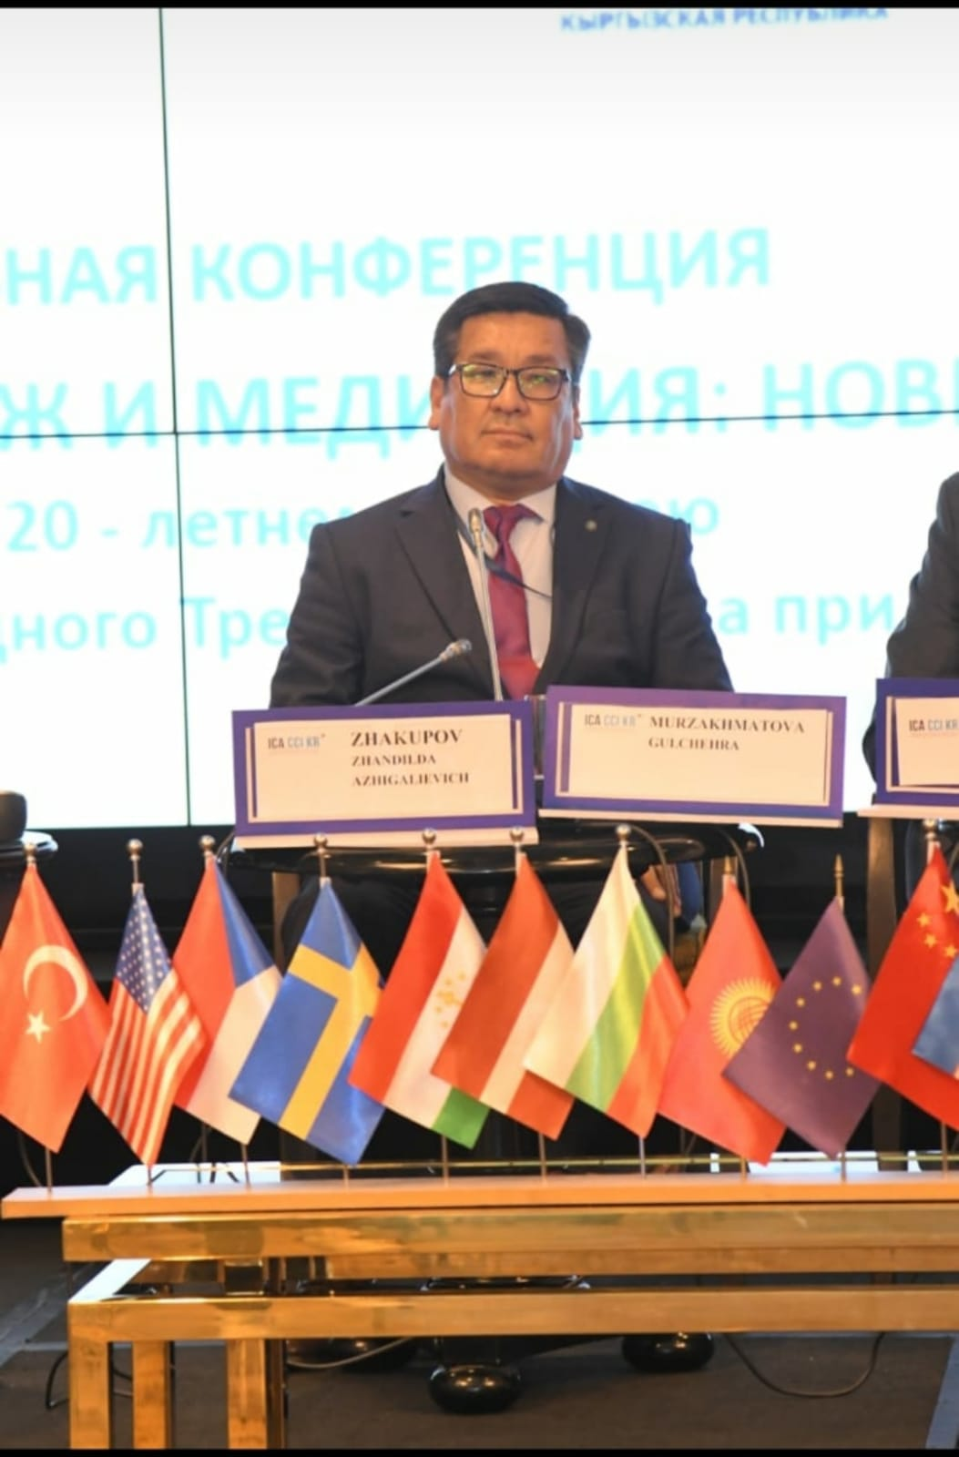
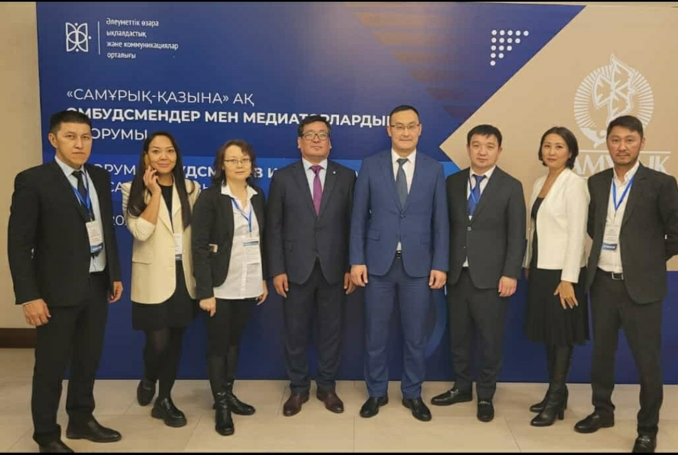
The IHC has extensive practical Kazakh and international experience in conducting mediation procedures, training mediators, preparing educational and methodological materials, proactive activities in developing proposals and recommendations for draft laws, cooperates with the Federal Institute of Mediation of Russia and other organizations of mediators in Kyrgyzstan, Uzbekistan, Azerbaijan, Tajikistan, Belarus , Ukraine, Georgia, Germany, Bulgaria, Spain and Turkey.
The MPC Mediation Center was accredited as a training center for training professional and corporate mediators and negotiators for the group of companies of the Samruk-Kazyna Foundation. Last year, the trainers of the center prepared a pool of 100 fund mediators with subsequent improvement of their qualifications

Slide 12
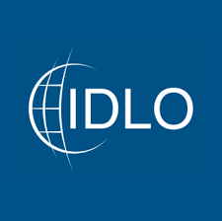
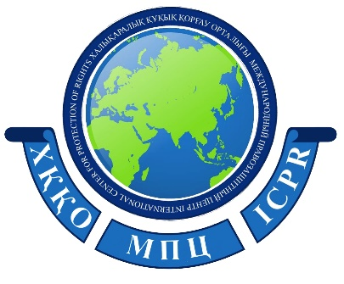
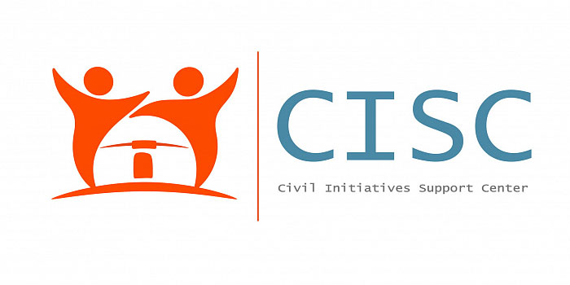
The IHC cooperates with Kazakhstani and foreign judicial, law enforcement and other state bodies and organizations on issues of legal and mediation assistance, conflict research and prevention, and is also an executor of international and national projects on these topics.
The IHC has implemented:
- Projects of international organizations (United Nations Development Program (4 years), Eurasia EFCA Public Foundation, USAID, IDLO, etc.).
- Projects of Kazakhstani non-governmental organizations (Public Foundation "Bota", etc.).
- State social orders of local executive bodies and Central Executive Bodies (ministries)
- Grants of the Center for Support of Civic Initiatives under the orders of the Ministries of the Republic of Kazakhstan.

Slide 13
Topics of IHC projects implemented independently and in partnership over 13 years:
"Judicial Mediation"
"School mediation"
“Explanation of the institution of mediation among the rural population of the Mangistau region”
“Development of interaction and dialogue in the Mangistau region”
“Organization of a national training course for mediators in the regions of Kazakhstan”
"Development and support of the activities of the Information and Educational Center on Mediation Issues" "Carrying out activities to prevent labor conflicts"
“Training the basics of mediation for non-professional mediators in the Kyzylorda region”
Carrying out a set of activities aimed at increasing legal literacy and legal responsibility of the population"
“Implementation of a project to improve the level of legal culture among the population and support the activities of the Information and Educational Center on Mediation Issues of the Mangystau Region.”

Slide 14
Topics of IHC projects implemented independently and in partnership over 13 years:
“Carrying out activities to identify social labor problems and prevent labor conflicts”
“Use of the institution of mediation to resolve social issues and maintain stability and harmony in society”
"Labor Patrol"
"Mediation in labor relations"
"Aleumet"
"Center for Reconciliation"
“Mobile groups for monitoring compliance with election legislation during elections to the Mazhilis of the Parliament of the Republic of Kazakhstan” seminars for election participants on negotiations and conflict management that arise during elections.
“Use of the institution of mediation to resolve social issues and maintain stability and harmony in society”
"Legal and mediative culture"
“Institutionalization of measures to strengthen family values among young people”
“Popularization of the institution of mediation and resolution of disputes among the population”

Slide 15
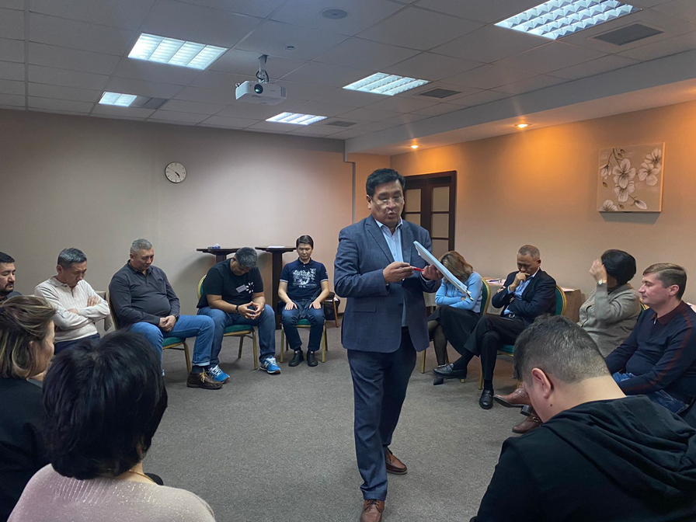
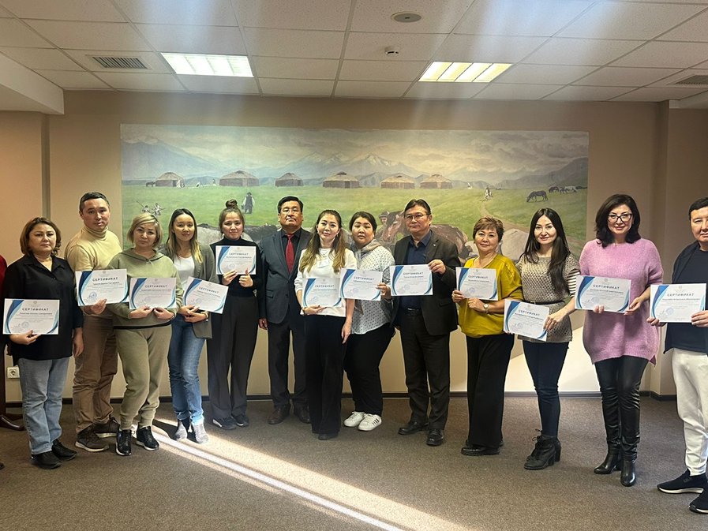
The MPC also operates a Center for Advanced Studies to conduct open and corporate training for individuals and legal entities on the following topics: -The art of negotiation - Profiling - Current issues of application of labor legislation and the basics of mediation for conciliation commissions - Extreme negotiations - Time management - Leadership and team building - Anti-corruption compliance - Strategic management and others.

Slide 16
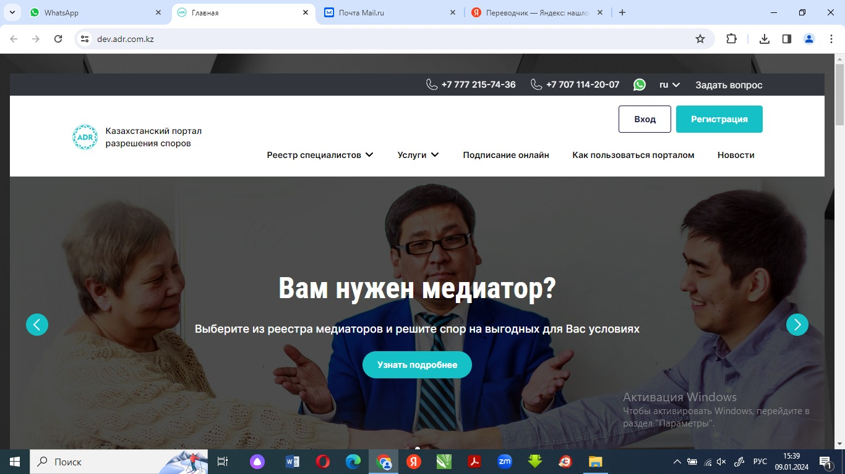
Introduction of an online mediation program and signing of documents using an electronic digital signature on the Kazakhstan Dispute Resolution Portal (site currently under development) • Author’s project of Zhandilda Zhakupov “E-mediation” • In Kazakhstan, electronic digital signatures are already moving to the QR code format; since last year, the Ministry of Informatization, together with IT companies, has been implementing a pilot project on international electronic digital signatures.

Slide 17
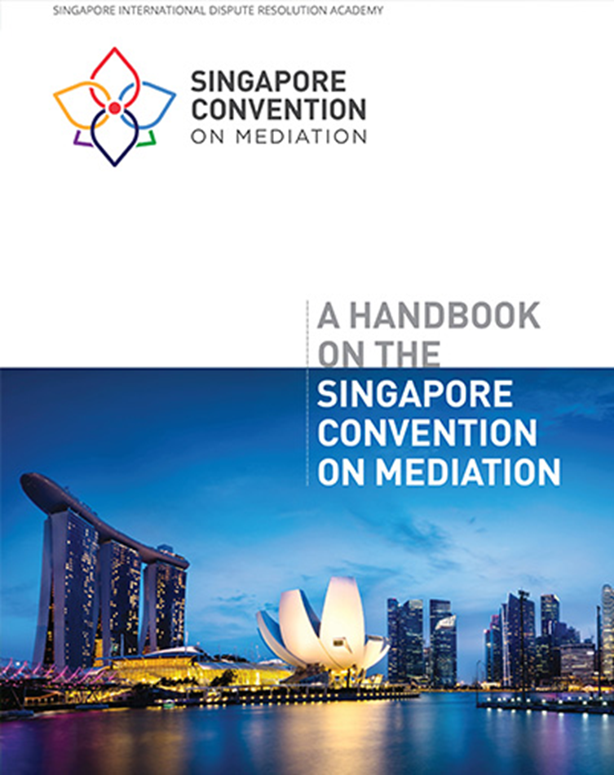
Международный опыт проведения медиаций и Сингапурская конвенция
In the register of mediators on the IHC website there is a special section for International Mediators, which contains experiences of mediators from conducting international mediations.
Mediations are carried out mainly in the CIS countries (Uzbekistan, Russia, Kyrgyzstan, Georgia), but there are also disputes with foreign countries (China, Italy, the Netherlands, Turkey, Switzerland)
Kazakhstan has signed and ratified the Singapore Mediation Convention with two reservations.
In previous years, a group of CIS experts organized and held an International Forum on the Singapore Convention, which contributed to resolving the issue of ratification of the Convention by our country. Kazakhstan was represented at the Forum by the head of the MPC Zhakupov Zh.A.

Slide 18
Proposals for cooperation:
• Conclusion of a Memorandum of Mutual Cooperation for the development of the institution of mediation in our countries
• Development and implementation of training educational projects on mediation for mediators, the judiciary and other interested professionals in Kazakhstan, Central Asia and the CIS.
• Conducting joint events on issues of mediation and law to improve the skills of lawyers and mediators in the field of mediation, exchange of experience, practice, legal norms in the field of mediation
• Studying and promoting issues of resolving cross-border disputes, maintaining joint registers of international mediators, organizing international mediations by mediators from our countries.
• Exchange of experience and development of online mediation and international electronic platforms for dispute resolution, including on our Kazakhstan dispute resolution portal adr.com.kz
• Attracting partners for cooperation, developing creative, effective, long-term mediation projects
• Involving international organizations to work together, whose activities are related to the preservation and strengthening of peace, conflict prevention, and the use of a mediation approach to resolving disagreements.

Slide 19
The International Human Rights Center Mediation Center School of Mediation and Negotiation
Head office: Republic of Kazakhstan,
Almaty, Mamyr-1district, building 29, office 103
Tel.+7-777-215-7436, +7-707-114-2007
mpc-info.kz
mediator01.kz
zhandilda.zhakupov
jandilda@mail.ru

